Slide 1
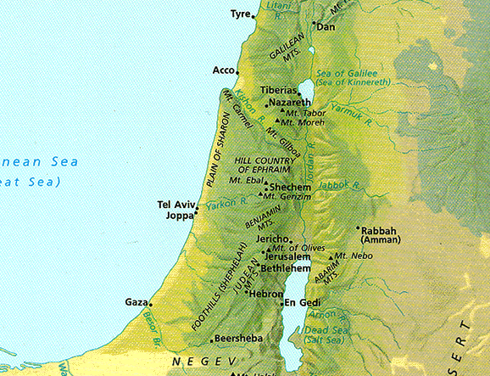
Israel
Longitudinal Areas
Southern Cities
Dead Sea Scrolls
Dr. Rick Griffith • Jordan Evangelical Theological Seminary • BibleStudyDownloads.org

Slide 2
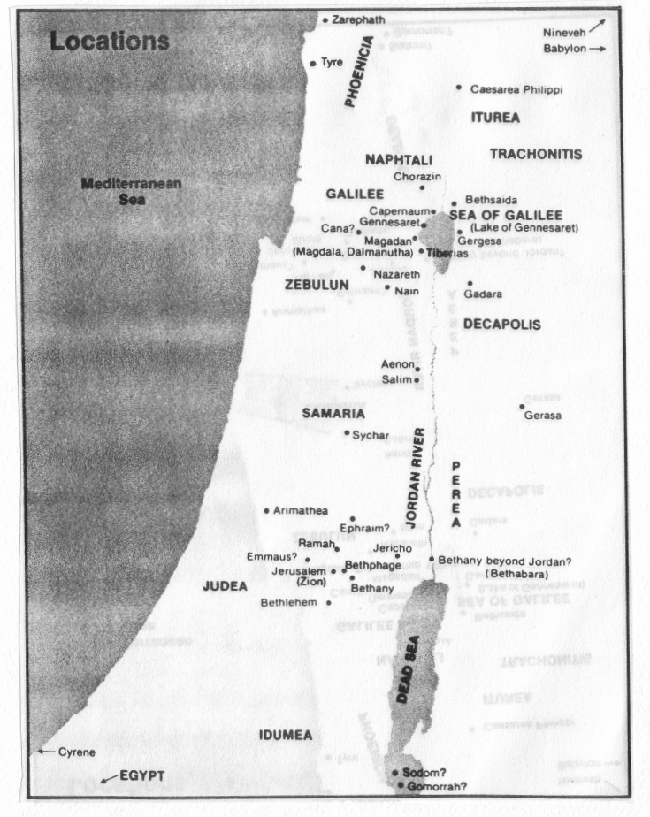
Quiz #2
2
Quiz #2: Every Geographical Location in the Gospels

Slide 3
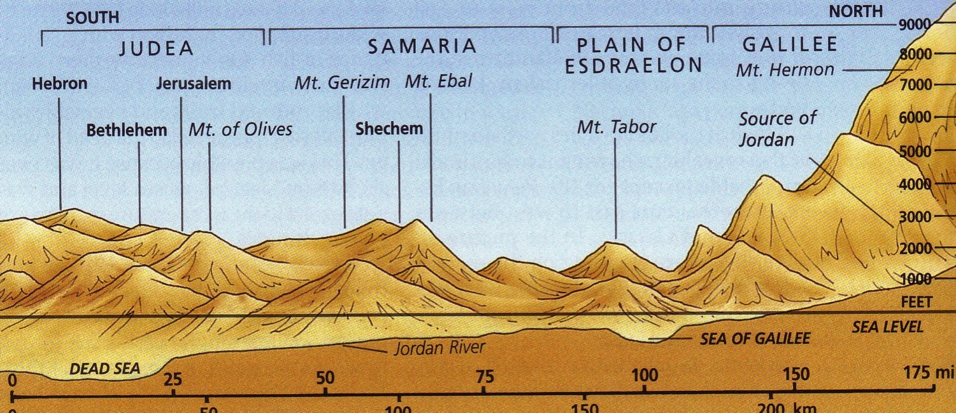
South-North Elevations
40

Slide 4
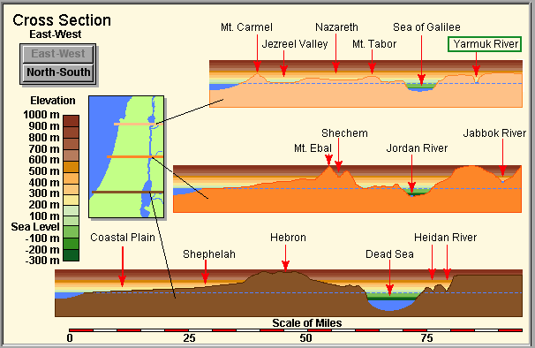
East-West Elevations
40

Slide 5

Elevations in North-South Divisions
40
Coastal Plain

Slide 6
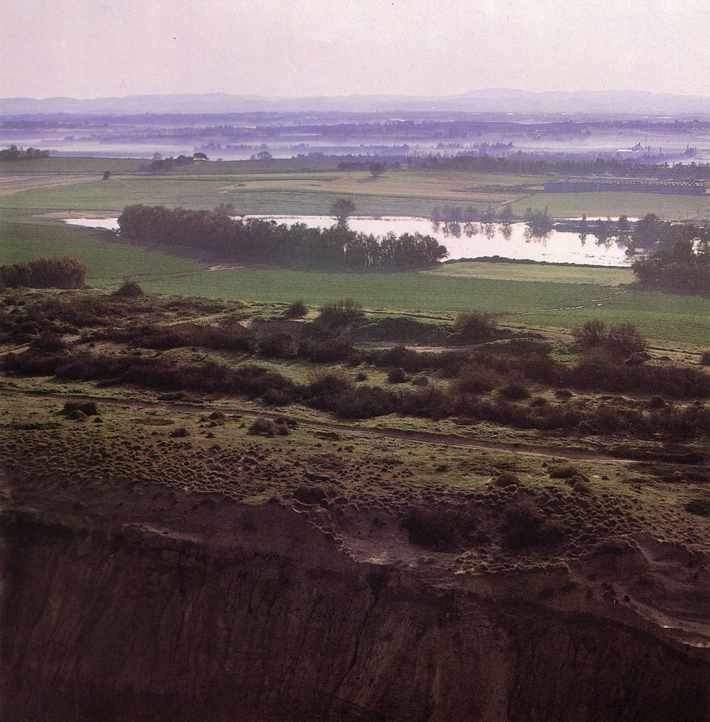
Coastal Plain
Kurkar (sandstone) ridges in the foreground while looking east to the foothills
Notes:
These ridges provide a natural barrier from water running westward to the Great Sea.

Slide 7
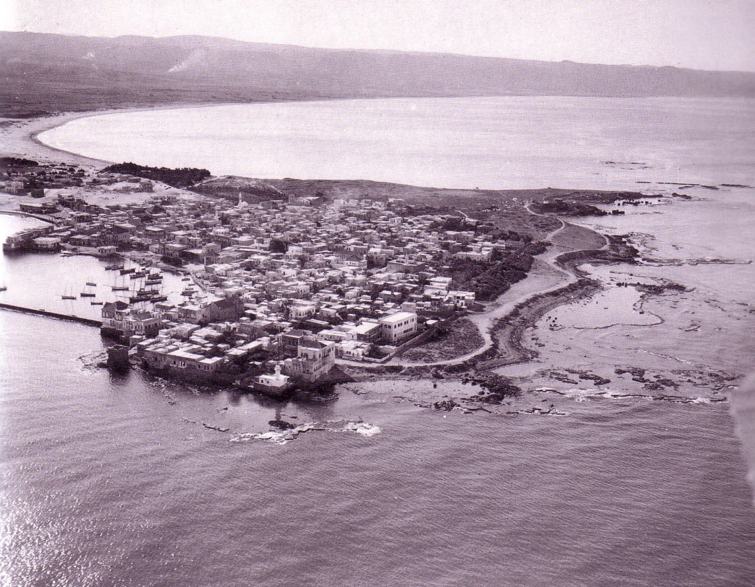
Coastal Plain
Tyre

Slide 8
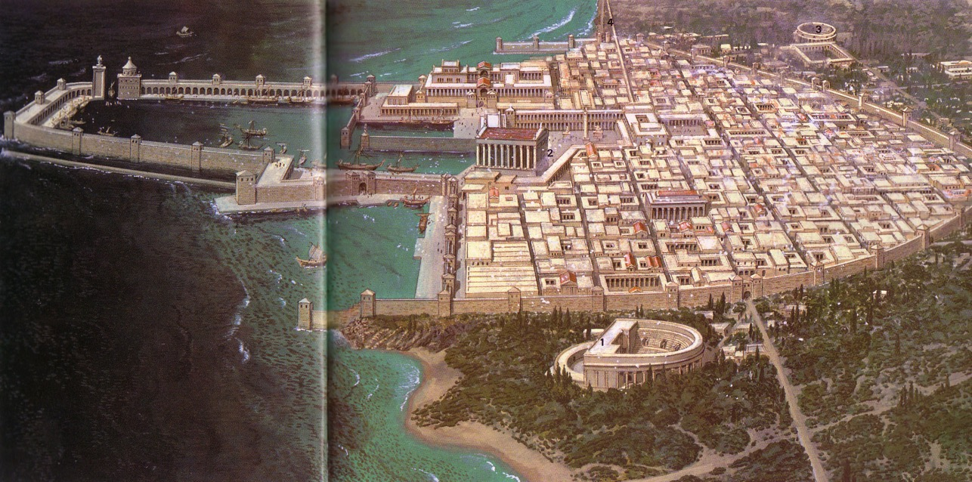
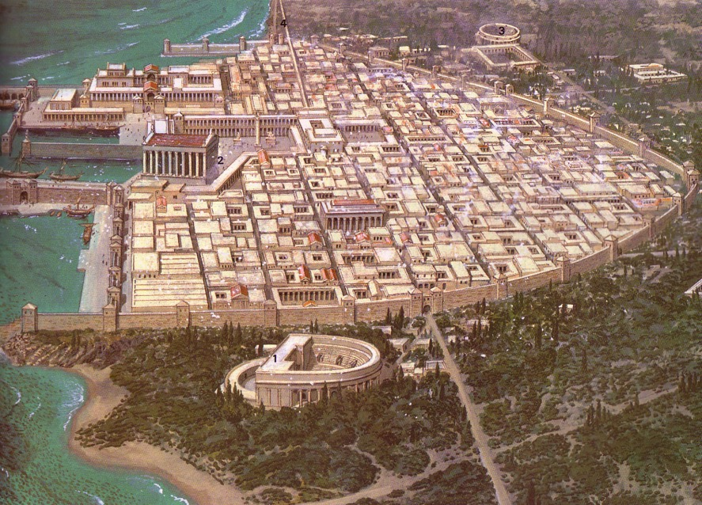
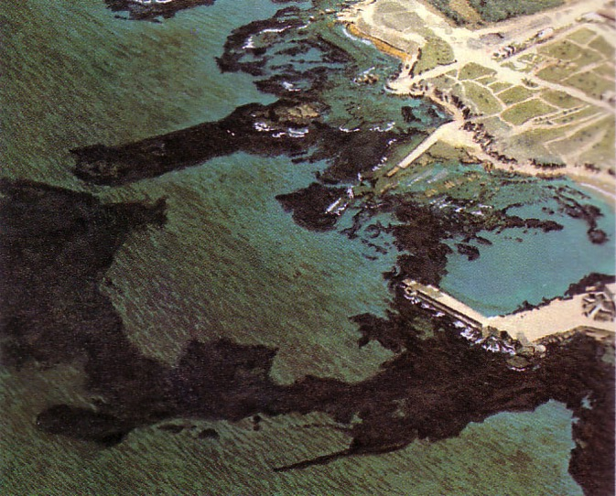
Coastal Plain
103
Caesarea

Slide 9
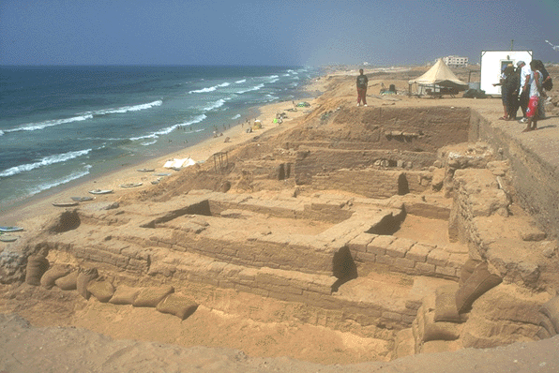
Coastal Plain
Gaza

Slide 10
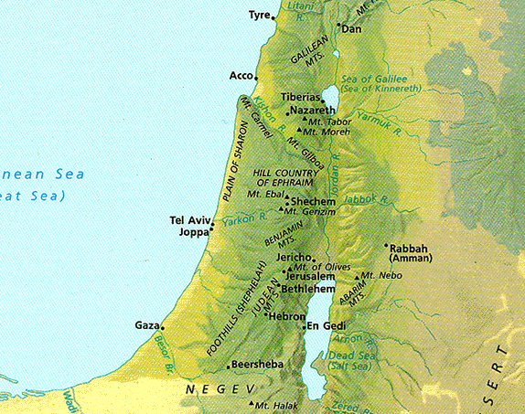
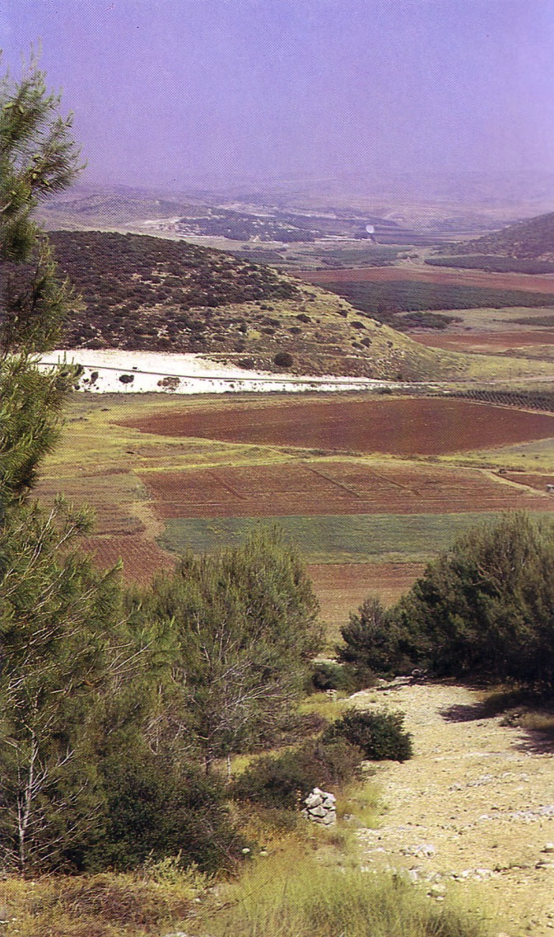
Elevations in North-South Divisions
40
Shephelah
Valleys and Hills

Slide 11
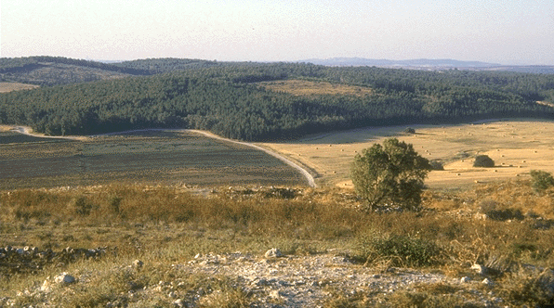
Shephelah
Farmland

Slide 12
Elevations in North-South Divisions
40
Central Mountain Range

Slide 13
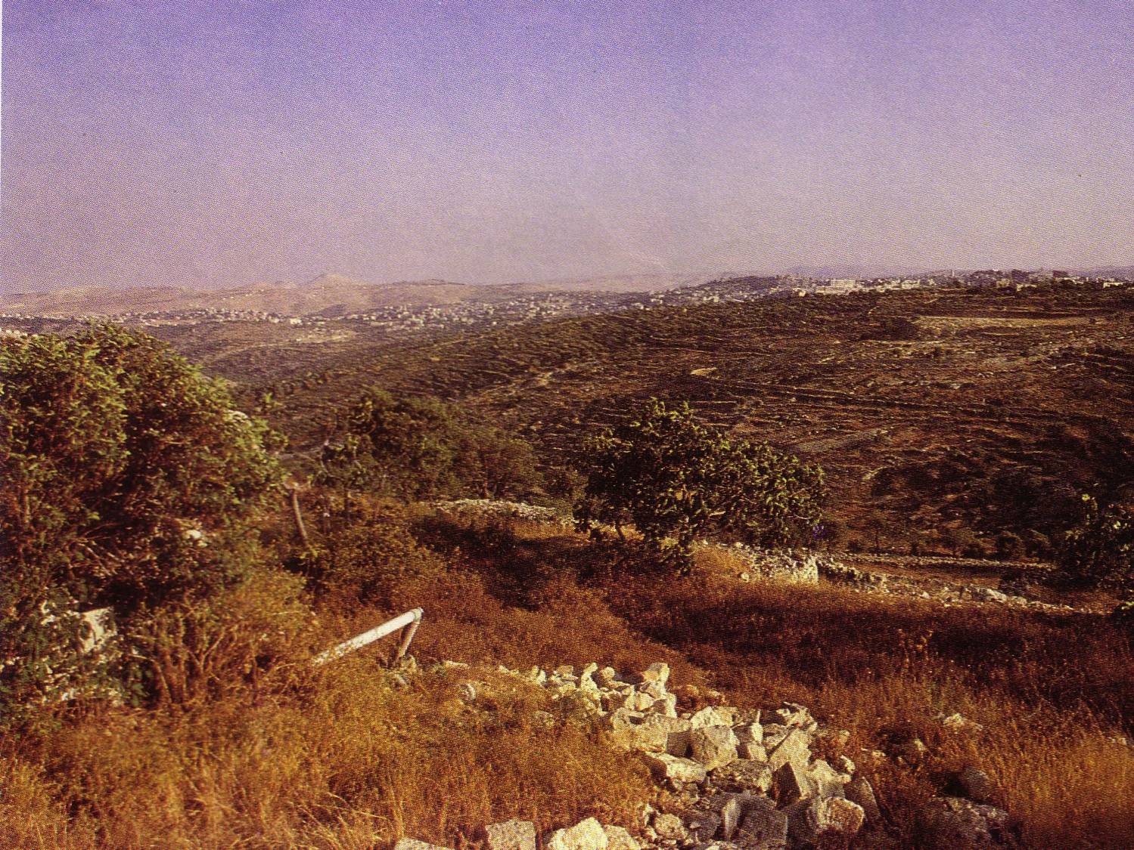
Judean Hills
40

Slide 14
Elevations in North-South Divisions
40
Also Called:
Plain of Megiddo
Jezreel
Valley
Central Mountain Range

Slide 15
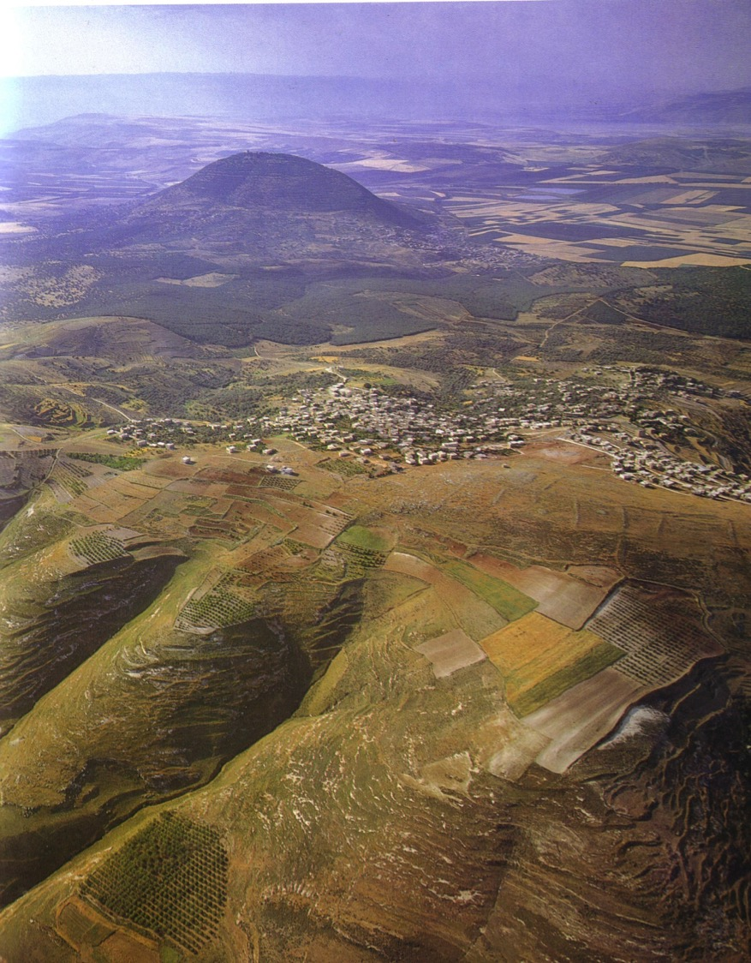
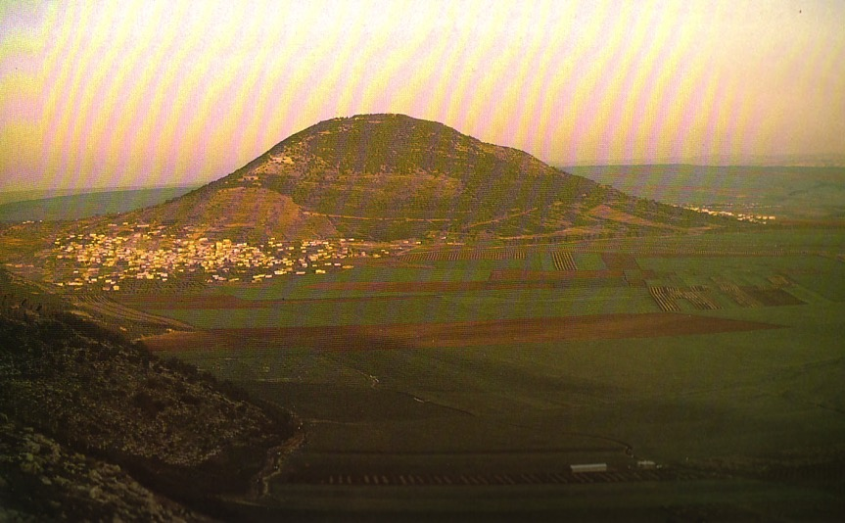
Mount Tabor in the Jezreel Valley
98

Slide 16
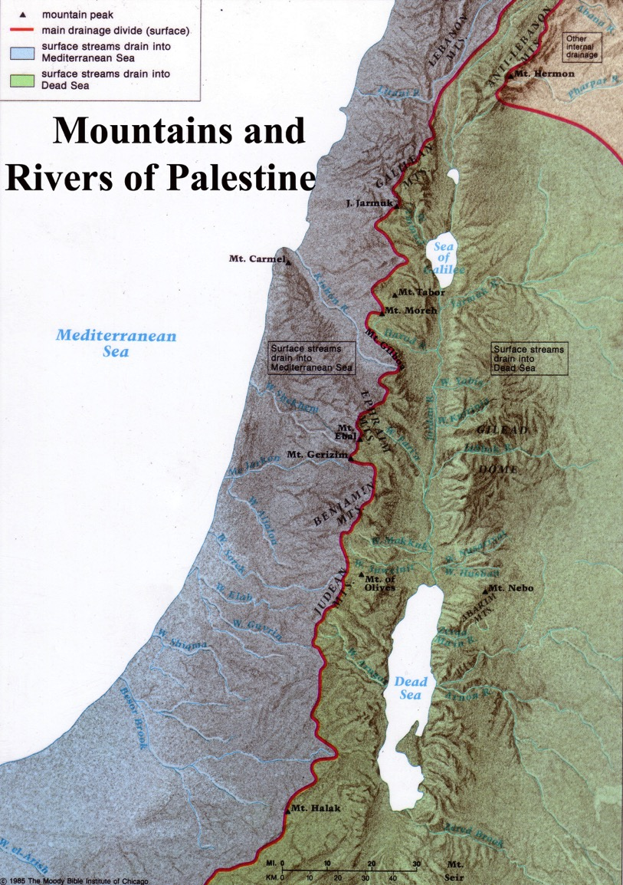
Central Mountain Range
A ridge causes water to flow east or west
The higher elevation is in the south

Slide 17
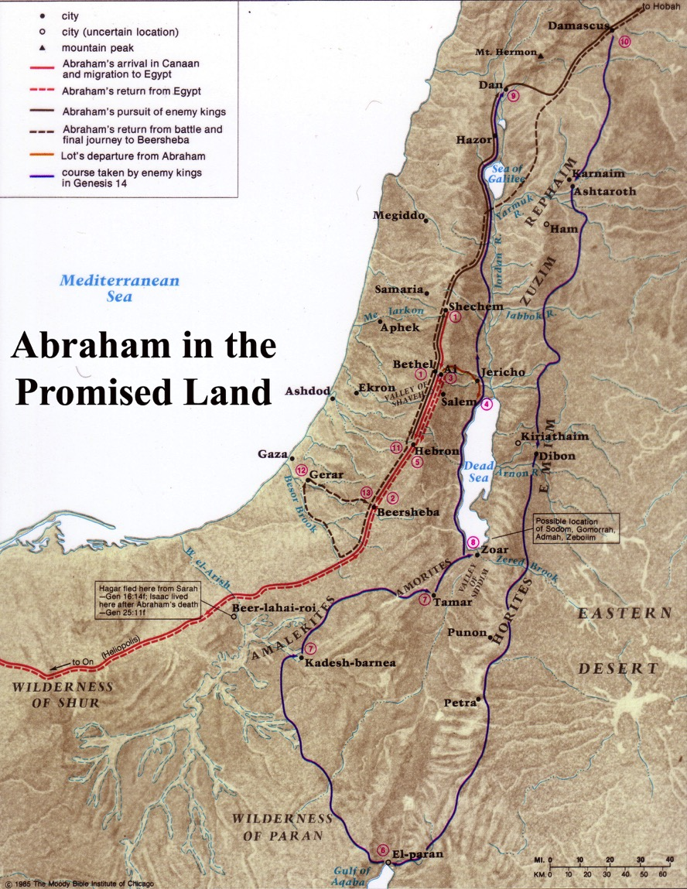
Abraham followed the Central Spine

Slide 18
The Wilderness of Judea

Slide 19
Elevations in North-South Divisions
40
Jordan Rift

Slide 20

Jordan Rift
Deep Depression
From the Wilderness of Judea looking east to the Salt Sea below

Slide 21
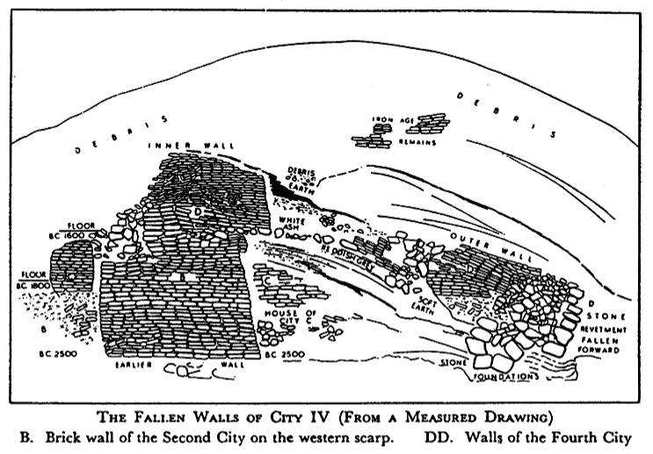
Jericho City
Inner Wall
D
Outer Wall
D
B
The Fallen Walls of City IV (From a Measured Drawing)
B. Brick wall of the 2nd City on the western scarp. DD. Walls of 4th City
Notes:
Note how the walls fell outwards which is unique among ancient cities.

Slide 22
Elevations in North-South Divisions
40
Transjordan Plateau

Slide 23
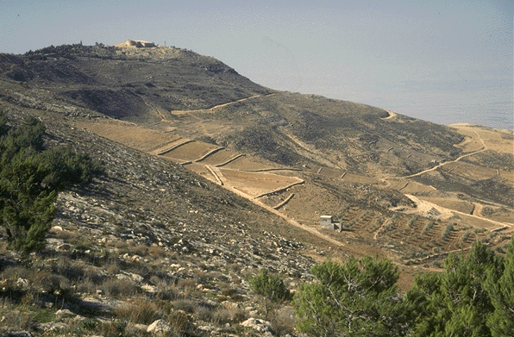
Transjordan Plateau
162
Mt. Nebo

Slide 24
Elevations in North-South Divisions
40

Slide 25
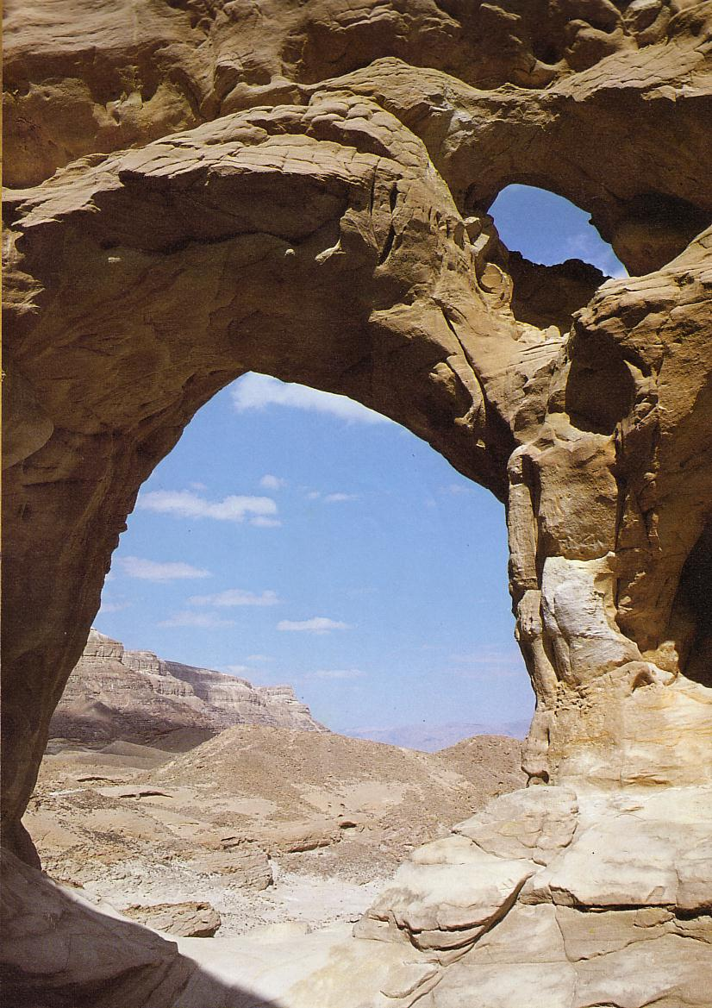
The Negev
54

Slide 26
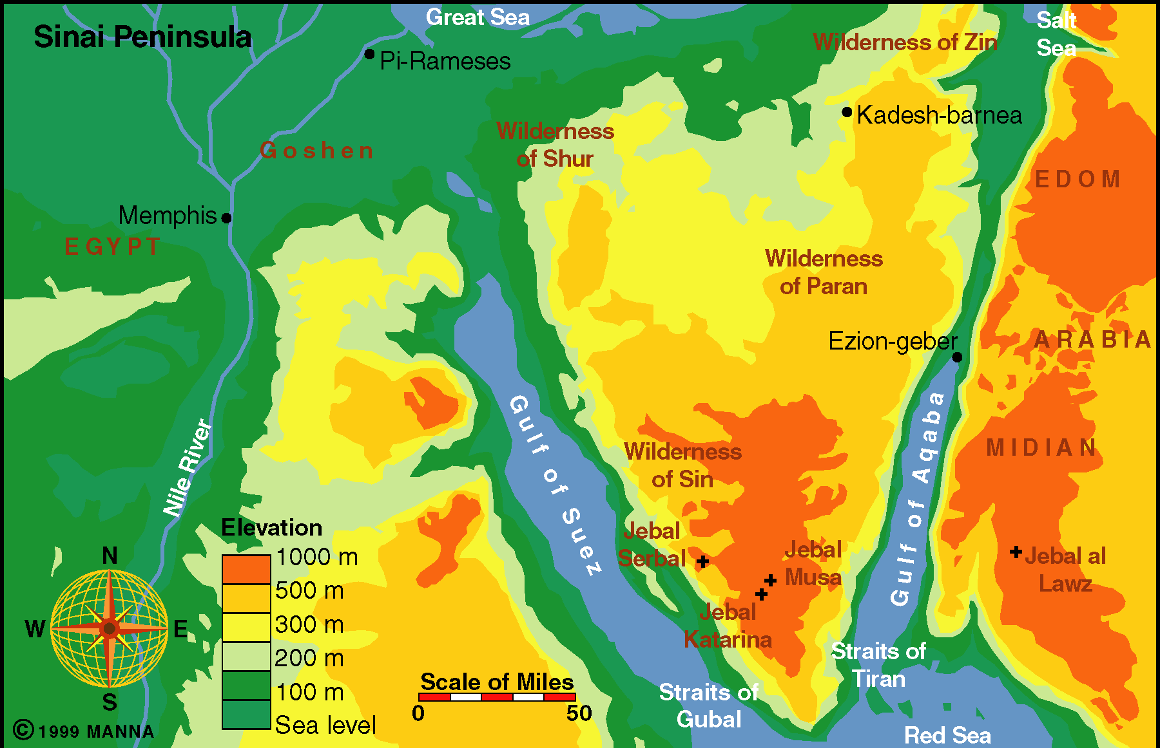
Sinai Peninsula
54

Slide 27


Egypt to Mesopotamia Trade

Slide 28
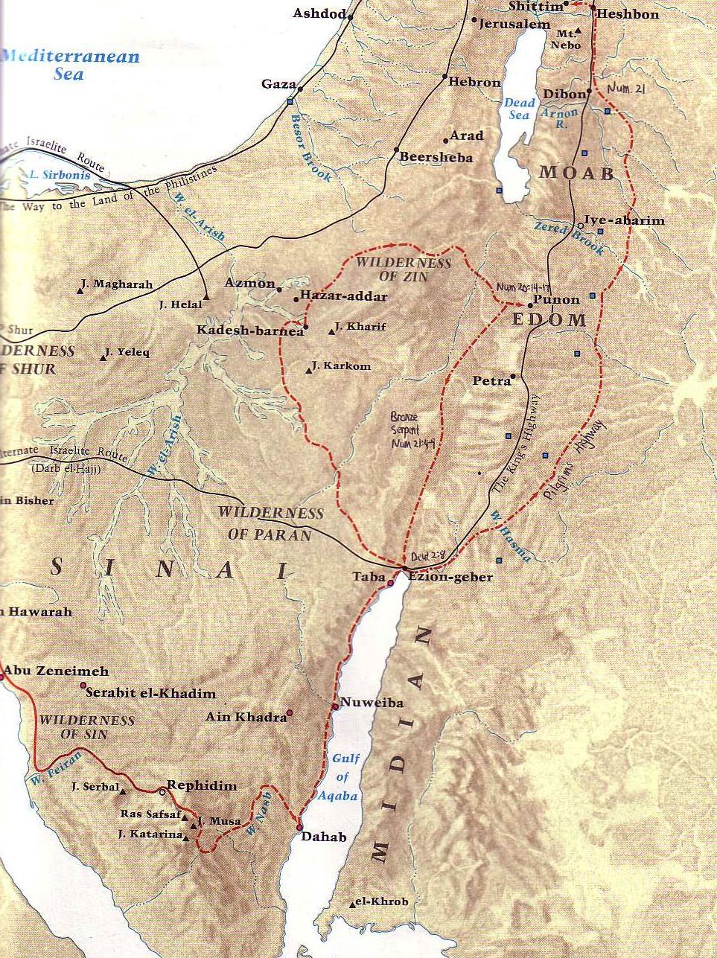
The King’s Highway
54
Petra
Barry Beitzel,
Moody Atlas of Bible Lands, 87

Slide 29
The Spice Trade

Slide 30
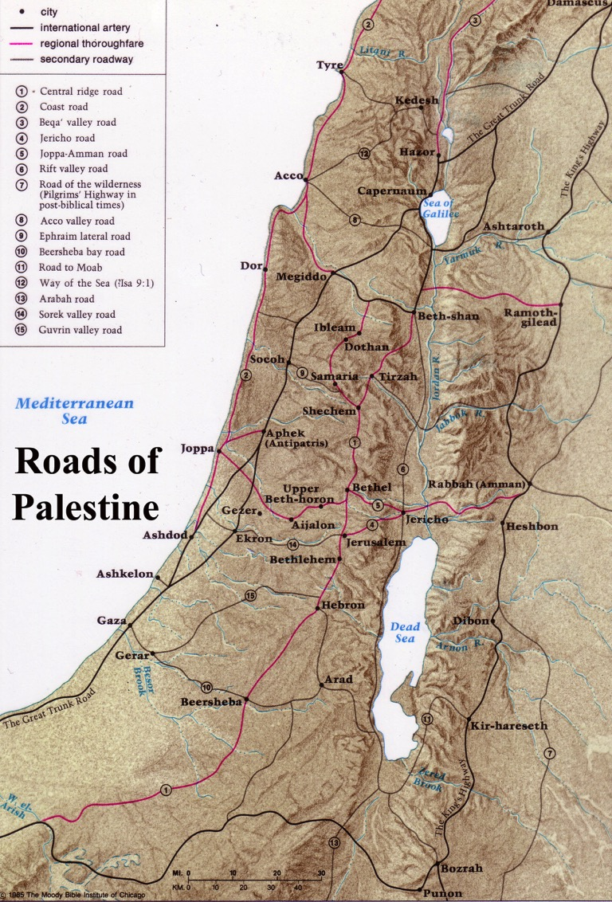
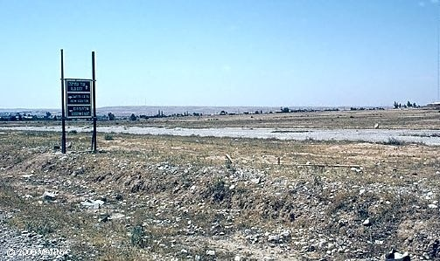
The Spice Trade Route
59

Slide 31
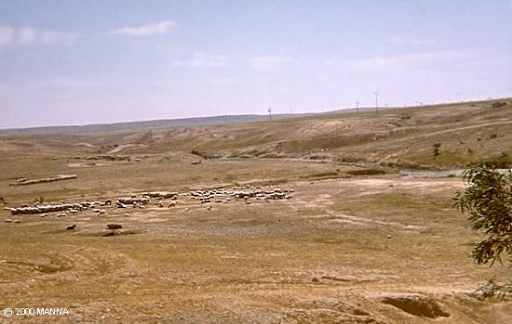
The Negev is desolate but sheep are now there

Slide 32
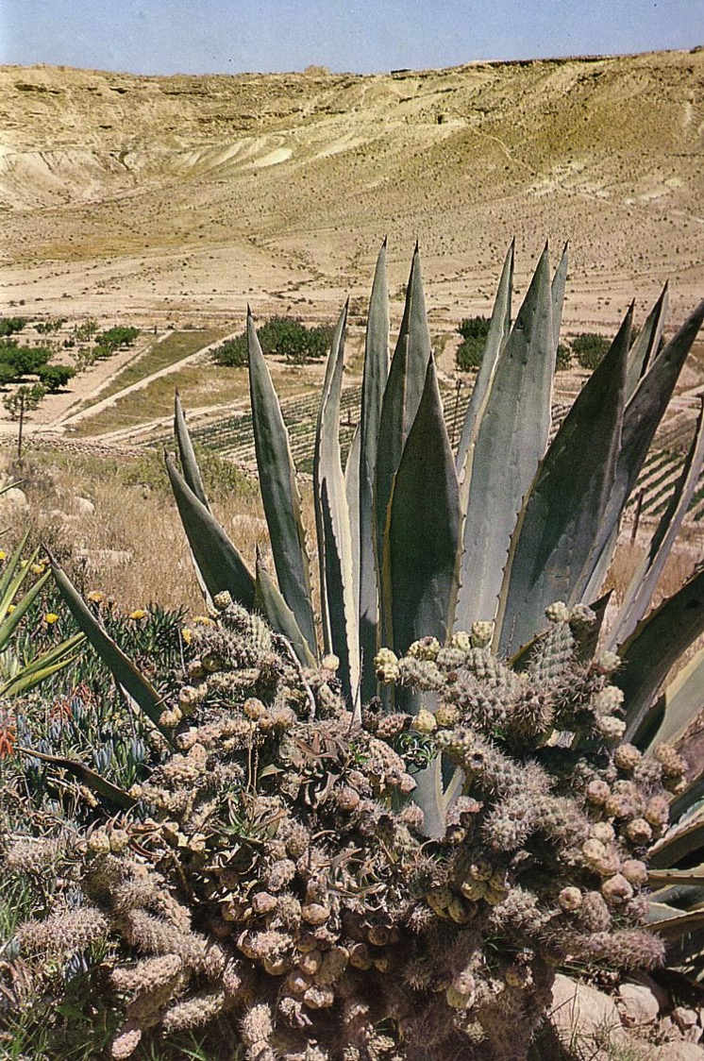
The Negev is Blooming!
Israel has a massive effort to water the Negev for crops and population redistribution.

Slide 33
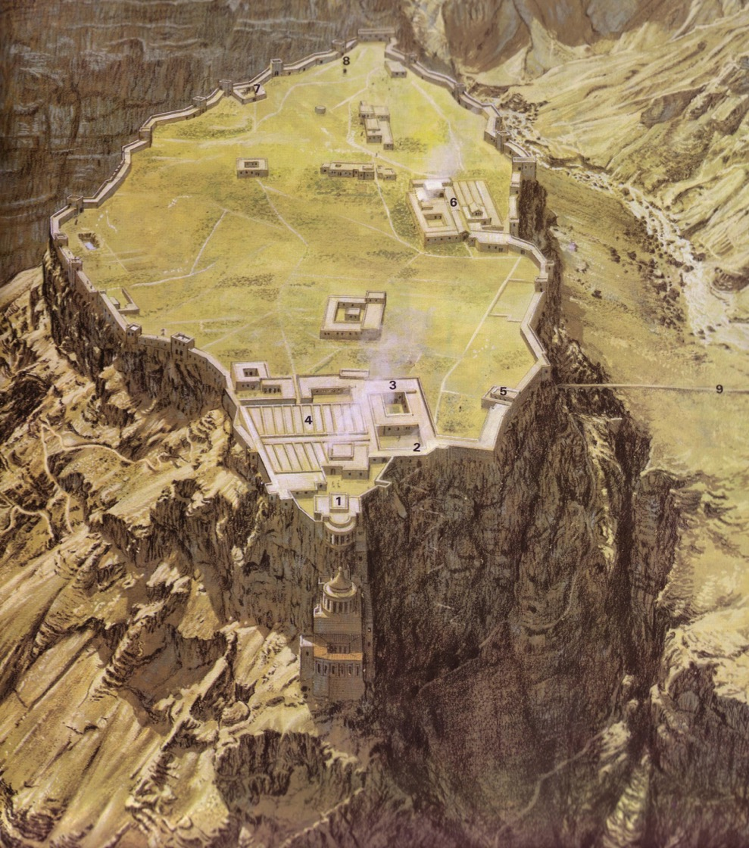
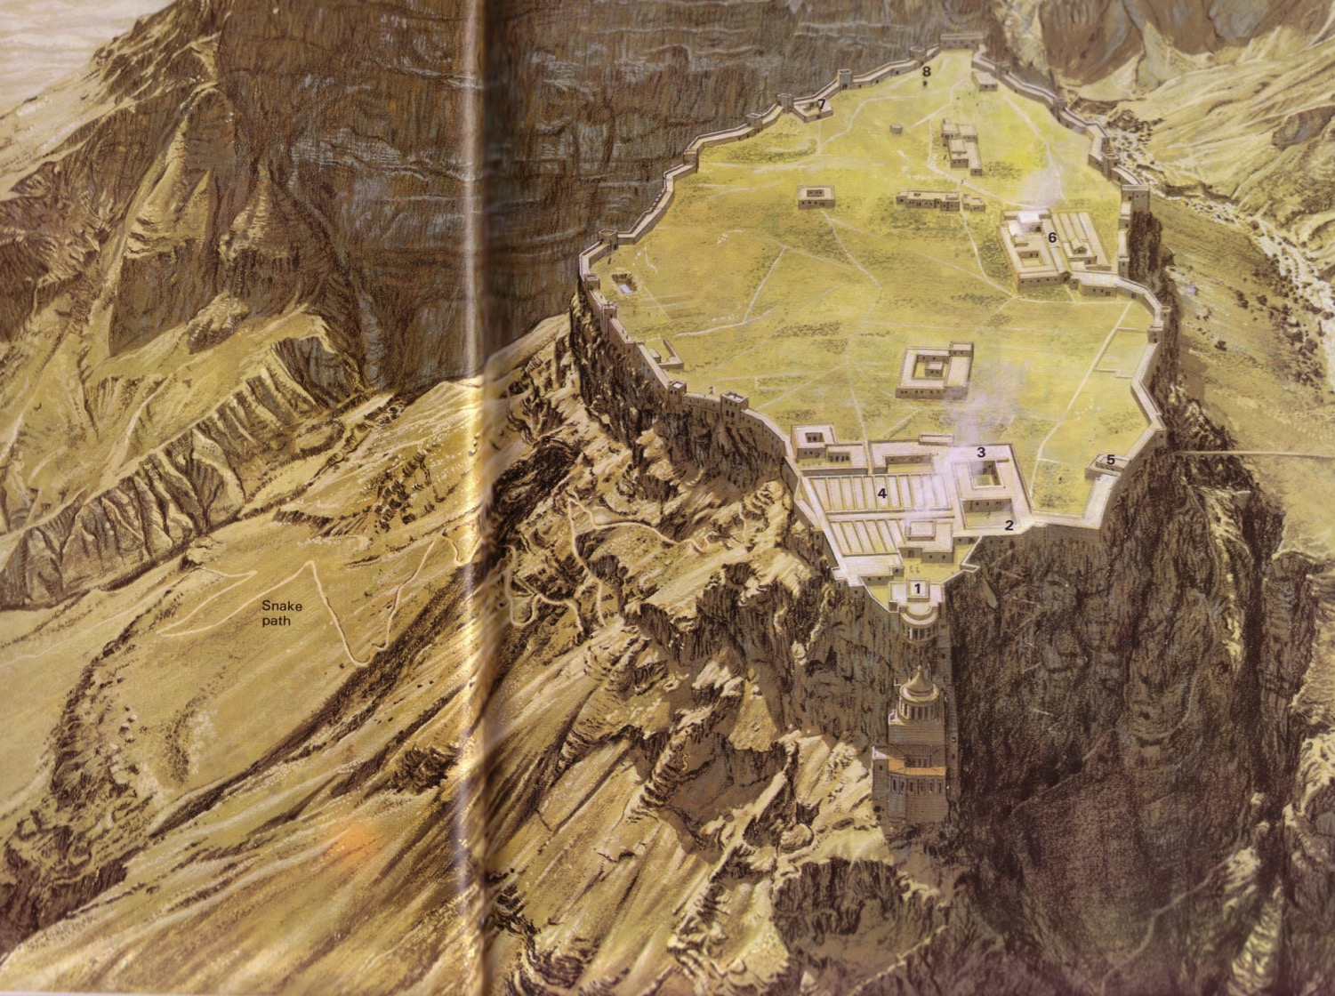
How would you conquer this fortress?!
68

Slide 34
Masada
68

Slide 35
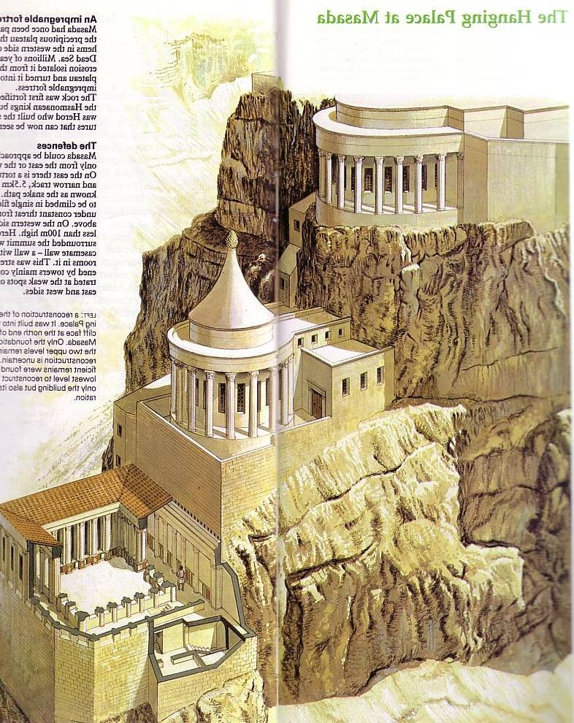
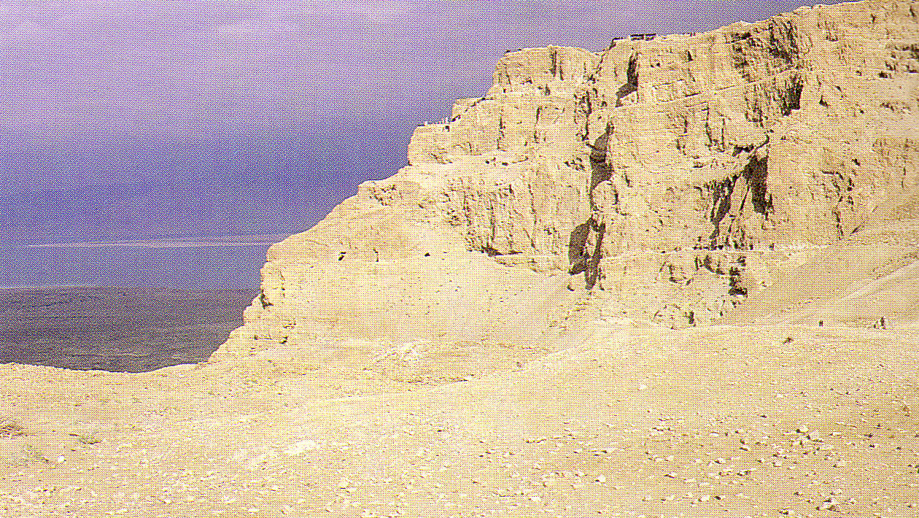
Northern Masada Palaces
67
Bath Houses

Slide 36
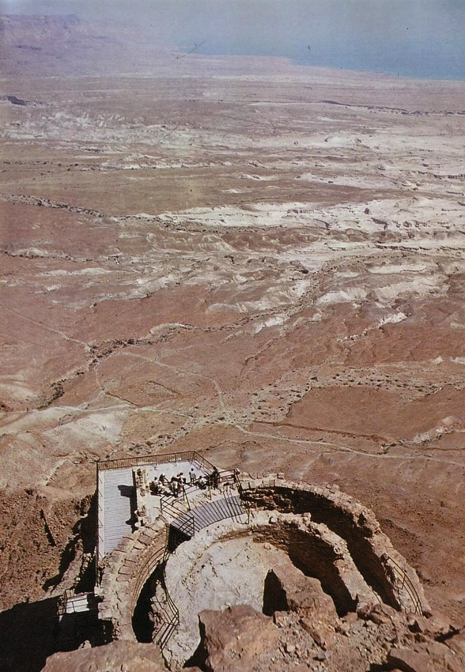
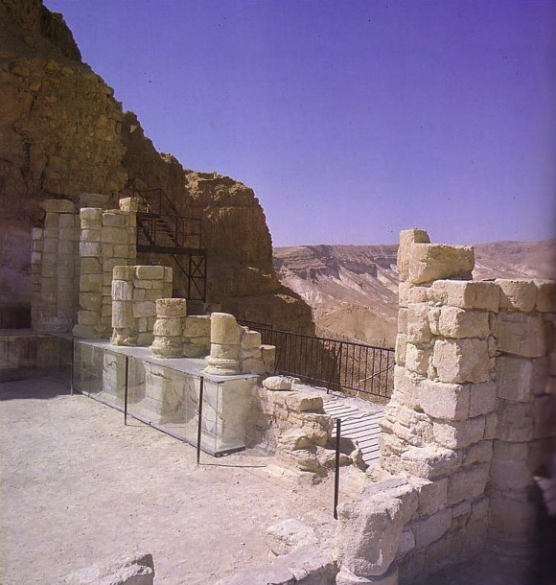
Herod’s Northern Masada Palace
67

Slide 37
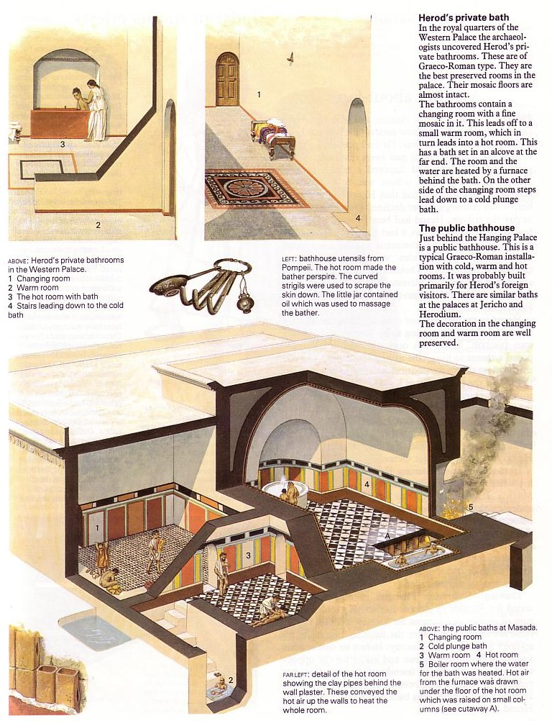
Masada
Bath Houses
69
Luxury living while your armies fight for you!

Slide 38
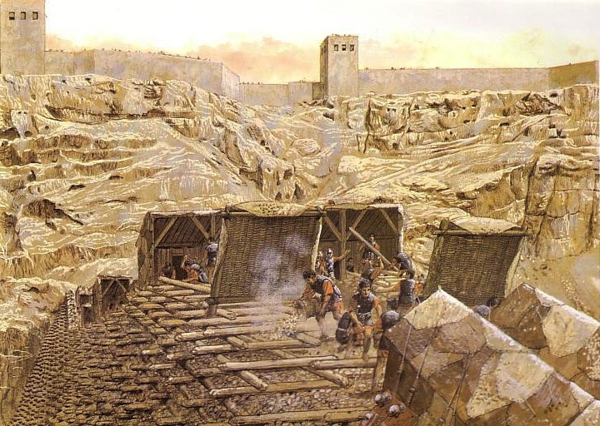
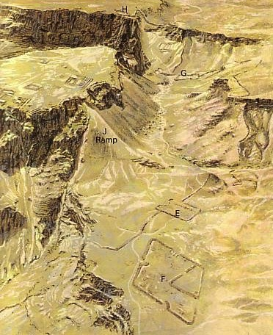
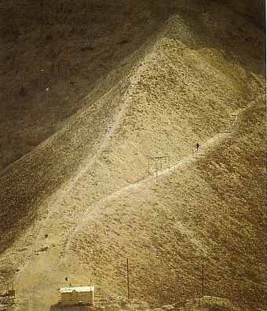
The Ramp of All Ramps

Slide 39
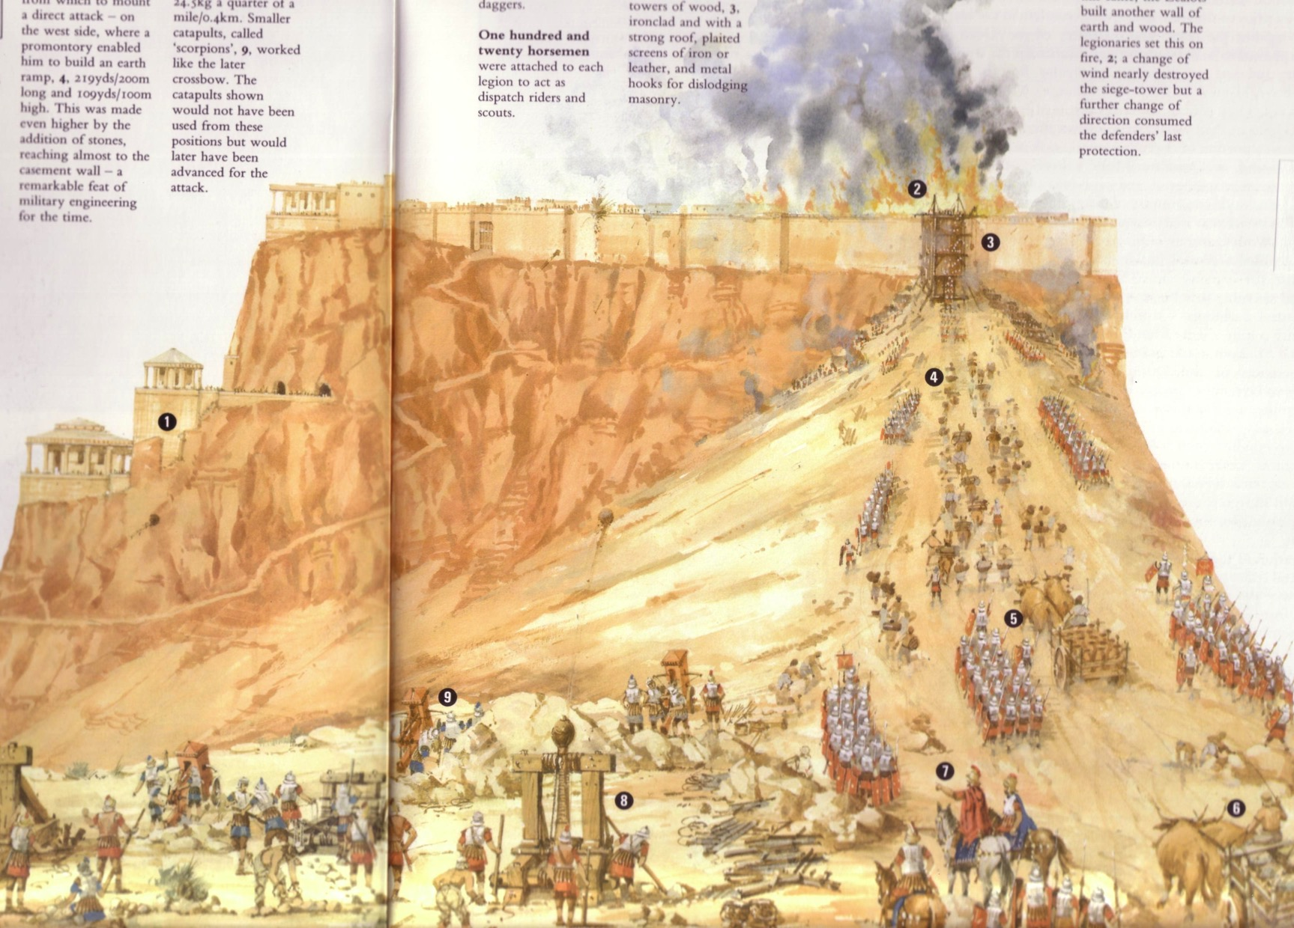
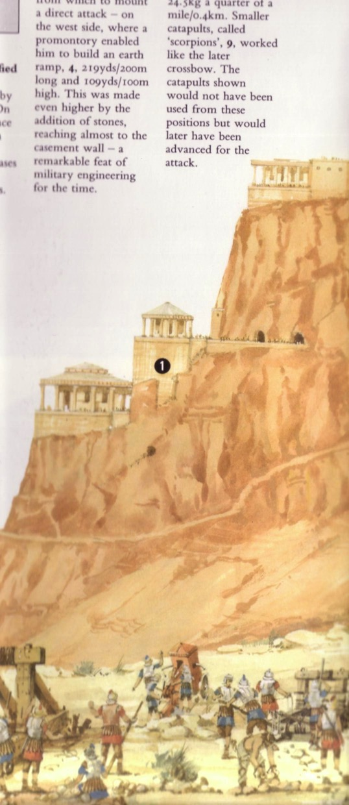
The Fall of Masada (AD 73)
The Fall of Masada (AD 73)

Slide 40
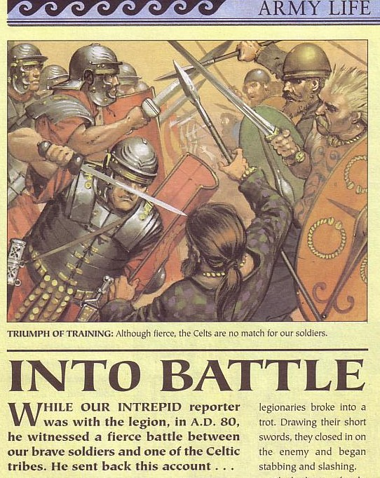
Rome Had a Fierce Army

Slide 41
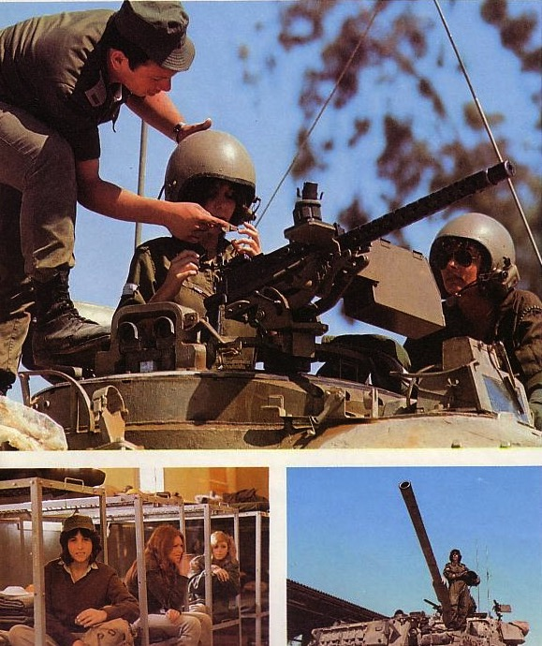

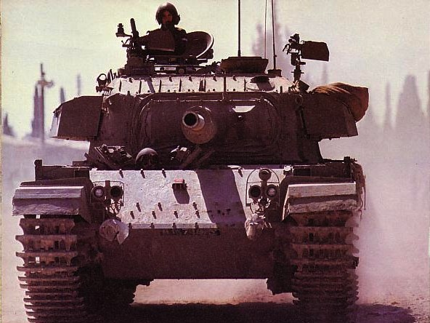
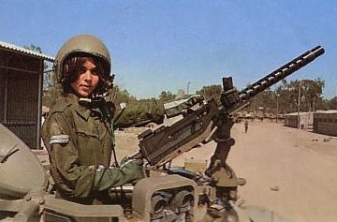
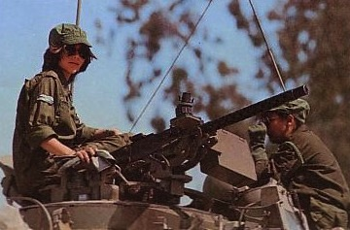
“Never Again!”

Slide 42
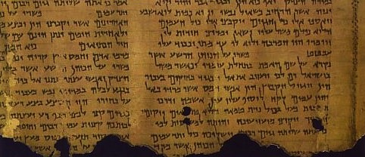
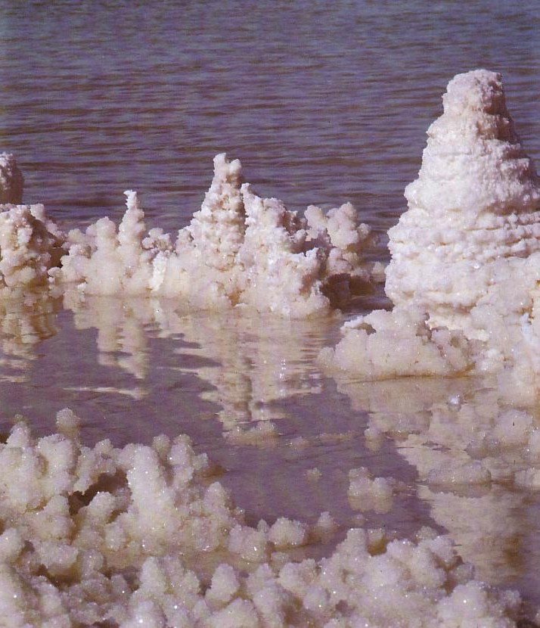
The Dead Sea Scrolls
71
The most significant literature found in the history of the church

Slide 43

Location of the Dead Sea
Sea of Galilee
The Great Sea
215 km. (135 mi.)
Jordan River
Salt Sea

Slide 44
Elevations in North-South Divisions
Jordan Rift

Slide 45
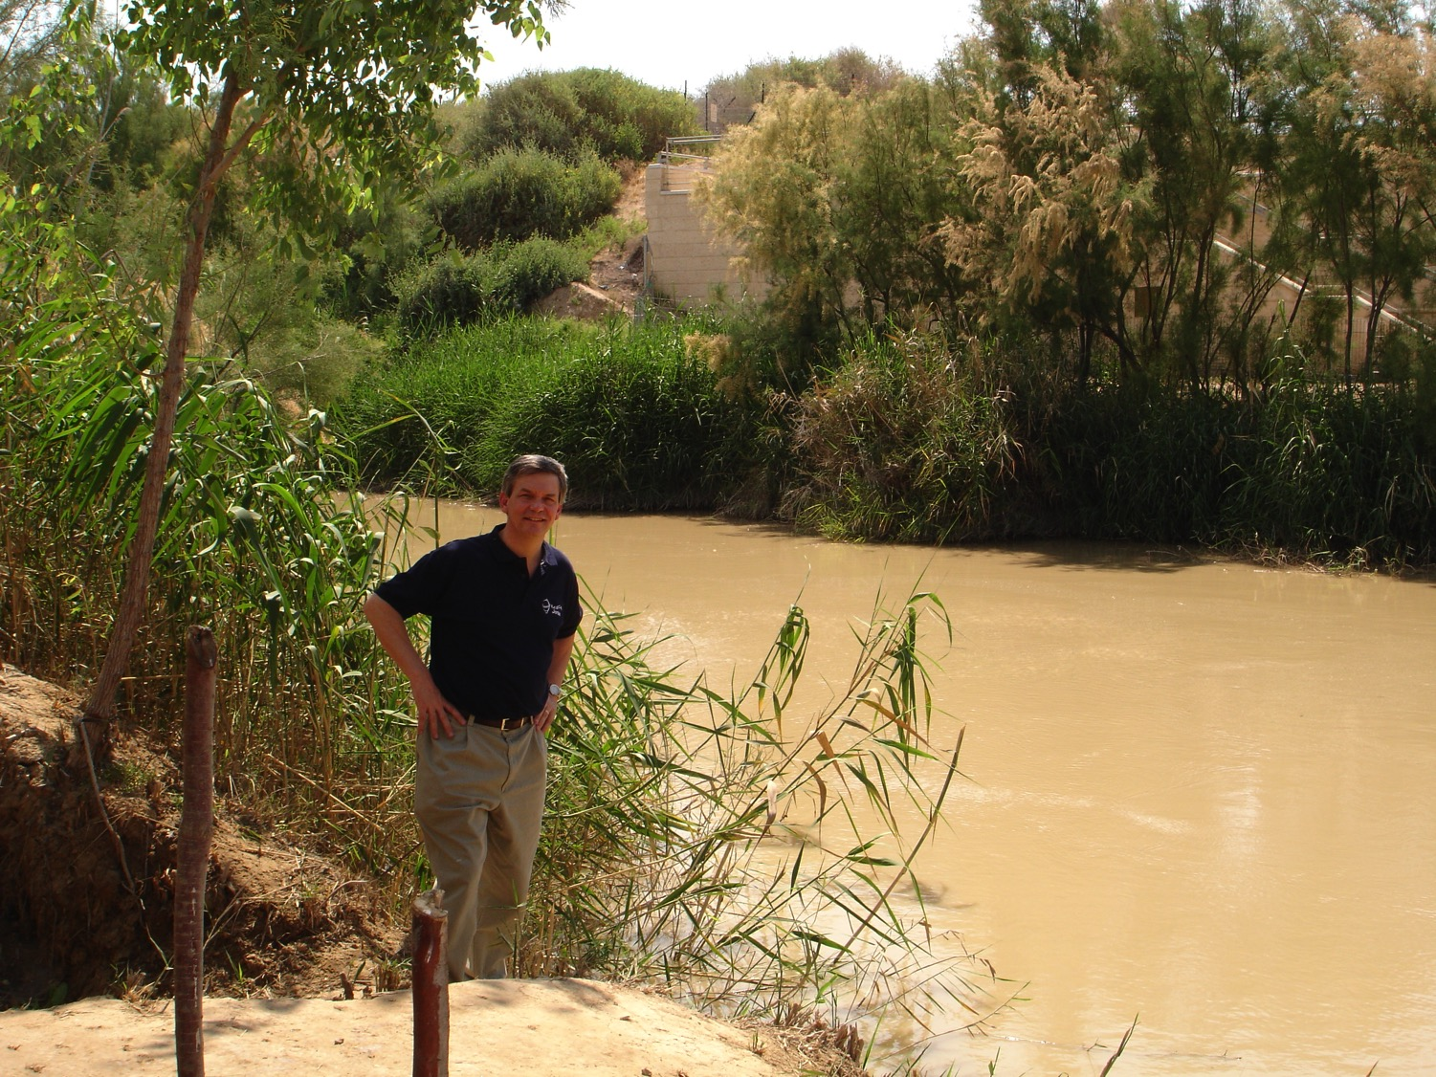
Baptismal Site of Jesus

Slide 46
The Jordan Rift
71
Deep Depression
From the Wilderness of Judea looking east to the Salt Sea below

Slide 47
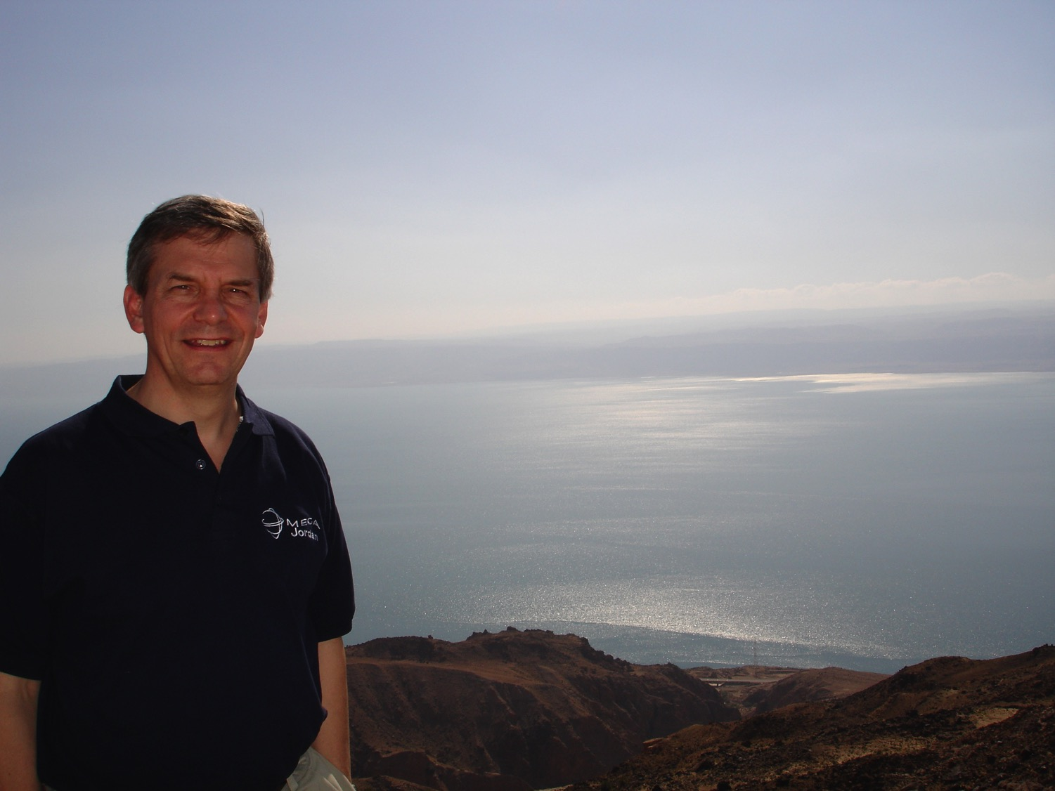
From the Heights

Slide 48
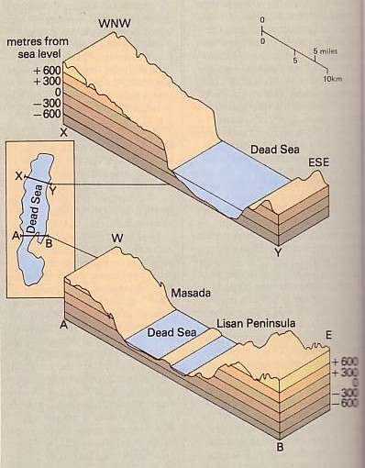
The lowest spot on earth
(-394 m.)
3-4 in. rain/year
3 sections now
Dropped 12 m. since 1975—was 20 m. higher in the 1st cent. AD
Israel makes US$1 billion/yr. from potassium for fertilizer

Slide 49
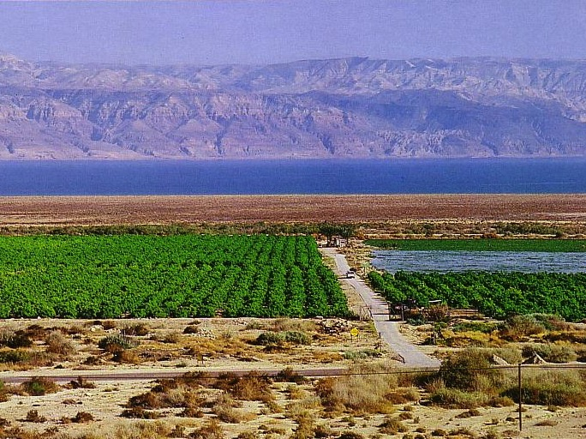
Crops from a Fresh Water Oasis

Slide 50




En Gedi
The Salt Sea

Slide 51


Resorts of Salt?

Slide 52

The Highest Salt Content on Earth
6 times the salt content of sea water
27% solids with 7% salt
Float effortlessly
No outlet

Slide 53

I enjoyed it too!

Slide 54


Dead Sea Mud
Great for the skin (they say)
You can't get too much

Slide 55

Rick, Randall, Tim

Slide 56

Stings the skin but feels great!

Slide 57

Pure Pleasure!?

Slide 58

History of the Dead Sea Scrolls
71
Seven scrolls were found (1947) and quickly published

Slide 59

History of the Dead Sea Scrolls
71
Seven scrolls were found (1947) and quickly published
Bar Kochba letters (1952, 1960-61)
Hundreds of scrolls and 18,000 fragments followed (1947-1956)

Slide 60

Tough Work!
Often gettingscrolls from the hills wasn't easy

Slide 61

Near Impossible Work
Sometimes it was near impossible!

Slide 62




The Qumran Ruins
74
De Vaux

Slide 63





Map of the Qumran Community
74

Slide 64






Finds at Qumran

Slide 65





The Qumran Community
76

Slide 66

Who were the Essenes?
76
North of En Gedi (Pliny the Elder)
"On the west side of the Dead Sea, but out of the range of the noxious exhalation of the coast, is the solitary tribe of the Essenes, which is remarkable beyond all the other tribes in the whole world, as it has no women and has renounced all sexual desire, has no money, and has only palm trees for company. Day by day the throng of refugees is recruited to an equal number by numerous [additions] of persons tired of life and driven thither by the waves of fortune to adopt their manners. Thus through thousands of ages (incredible to relate), a race in which no one is born lives on forever; so prolific for their advantage is other men's weariness of life! Lying below them [Essenes] was formerly the town of En Gedi
(Pliny, Natural History 2)
Notes:
trans. H. Rackham, Loeb Classical Library [London: Heinemann/Cambridge, MA: Harvard Univ. Press, 1969], 5.15, 73

Slide 67

Who were the Essenes?
76
North of En Gedi (Pliny the Elder)
No marriage (Josephus)

Slide 68


Who were the Essenes?
76
North of En Gedi (Pliny the Elder)
No marriage (Josephus)
Scriptorium
Sectarian writings

Slide 69

Why did the Essenes form?
76
The high priesthood was corrupt
Annas & Caiaphas of the NT era continued the corrupt practices of Jason and Menelaus (175 BC). So the Essenes withdrew to the desert during the reign of Simon (143-135 BC)

Slide 70

What Scrolls were Found?
77
Every OT book but Esther (e.g., 11QPs)
Apocrypha and Pseudepigrapha
Commentaries (e.g., 1QpHab)
Collections of OT passages on a theme
Sectarian writings
  Manual of Discipline
  Temple Scroll
  War Scroll

Slide 71


The Copper Scrolls
78
Provide detailed plans for the third temple

Slide 72
What Scrolls were Found?
78
Every OT book but Esther (e.g., 11QPs)
Apocrypha and Pseudepigrapha
Commentaries (e.g., 1QpHab)
Collections of OT passages on a theme
Sectarian writings
  Manual of Discipline
  Temple Scroll
  War Scroll
No NT manuscripts

Slide 73


Shrine of the Book
Significance of the DSS
79
5. Proves conservative dating of OT books
When was Daniel written?
Conservatives
say 560 BC
Liberals
say 164 BC
DSS Daniel copy
200-100 BC
600
500
400
300
200
100
BC

Slide 74


Significance of the DSS
80
This Isaiah scroll matches the A.D. 1000 Masoretic Text upon which all modern translations are based 99% of the time.
6. Transmission of OT accurate
Masoretic Isaiah Scroll
Isaiah AD 1000
1200 years earlier!
Isaiah 200 BC
Dead Sea Isaiah Scroll

Slide 75

Significance of the DSS
72, 78
7. MMT shows that Paul's opponents who taught salvation by the law were indeed real people.
MIQSAT MA'ASE HA-TORAH
"works of the law" (Abegg's translation gives evidence for rabbinic belief in salvation by works, which Paul argues against in Galatians.)

Slide 76

Paul versus Legalists
Legalists
Paul
"The one who does righteousness stores up life for himself with the Lord"
Psalms of Solomon
(about 50 BC)
"Miracles, however, will appear at their own time to those who are being saved by their works"
2 Baruch
(about AD 100)
"But now God has shown us a way to be made right with him without keeping the requirements of the law, as was promised in the writings of Moses and the prophets long ago. ²² We are made right with God by placing our faith in Jesus Christ. And this is true for everyone who believes, no matter who we are"
(Rom. 3:21-22 NLT)
Notes:
BG-06-Israel-South Longitude Masada Qumran—76
NS-09-Galatians-189

Slide 77

Paul versus Legalists
154k
Legalists
Paul
"The one who does righteousness stores up life for himself with the Lord"
Psalms of Solomon
(about 50 BC)
"Miracles, however, will appear at their own time to those who are being saved by their works"
Baruch
(about AD 100)
"Let me ask you this one question: Did you receive the Holy Spirit by obeying the law of Moses? Of course not! You received the Spirit because you believed the message you heard about Christ."
(Gal. 3:2 NLT)
Notes:
BG-06-Israel-South Longitude Masada Qumran—77
NS-09-Galatians-71
But the Galatians inherited the traditional view and the view taught at Qumran and by the rabbis that only good people go to heaven. This is clear in the letter called MMT at Qumran—as seven copies of it were dug up and it is the only letter along with 870 scrolls!

Slide 78

Where did John grow up?
80
^{NIV} Luke 1:80 And the child grew and became strong in spirit; and he lived in the desert until he appeared publicly to Israel.
The Wilderness of Zin

Slide 79

John the Baptist
184
Where did John get the concept of immersion and repentance?

Slide 80

Essenes loved the Word of God

Slide 81



John the Baptist
Where did John get the concept of immersion and repentance?

Slide 82

The Essenes vs. John & Jesus
81
Essenes & John
Essenes & Jesus
Appeal to Isaiah 40:3
Call to repentance & baptism
Anticipated imminent kingdom of God
Water, spirit, & fire
Strange diet
Criticized religious leaders
Criticized temple leaders
Forbade divorce & remarriage
Spiritual offerings
Saw God's people as spiritual temple

Slide 83
Black

Slide 84


Bible Geography link at BibleStudyDownloads.org
Get this presentation for free!
Notes:
Bible Geograhpy (bg)

